Slide 1
Elements of Econometrics. Lecture 3. Simple Linear Regression Model (continued).
FCS, 2022-2023

Slide 2



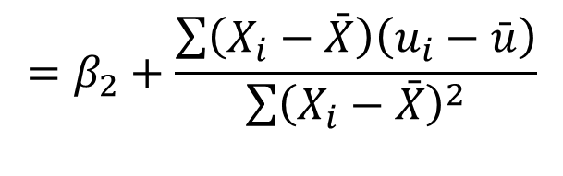
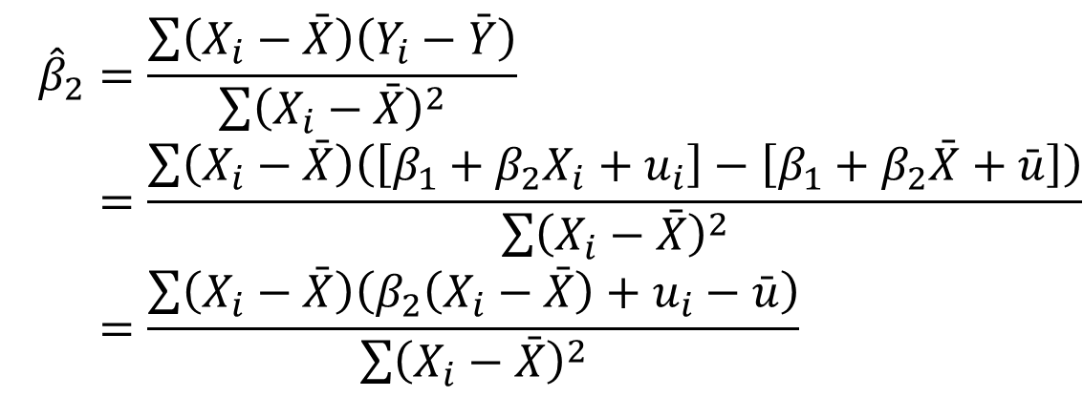
REGRESSION COEFFICIENTS: FIXED AND RANDOM COMPONENTS
True model Fitted model
$$Y=β_{1}+β_{2}X+u$$
$$\hat{Y}={\hat{β}}_{1}+{\hat{β}}_{2}X$$
$${\hat{β}}_{2}=\frac{\sum{\left(X_{i}−\bar{X}\right)\left(Y_{i}−\bar{Y}\right)}}{\sum{{\left(X_{i}−\bar{X}\right)}^{2}}} \\ =\frac{\sum{\left(X_{i}−\bar{X}\right)\left(\left[β_{1}+β_{2}X_{i}+u_{i}\right]−\left[β_{1}+β_{2}\bar{X}+\bar{u}\right]\right)}}{\sum{{\left(X_{i}−\bar{X}\right)}^{2}}} \\ =\frac{\sum{\left(X_{i}−\bar{X}\right)\left(β_{2}\left(X_{i}−\bar{X}\right)+u_{i}−\bar{u}\right)}}{\sum{{\left(X_{i}−\bar{X}\right)}^{2}}}$$
$$=β_{2}+\frac{\sum{\left(X_{i}−\bar{X}\right)\left(u_{i}−\bar{u}\right)}}{\sum{{\left(X_{i}−\bar{X}\right)}^{2}}}$$
$${\hat{β}}_{2}$$
We decompose into its nonrandom and random components.

Slide 3
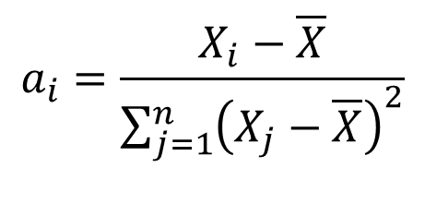
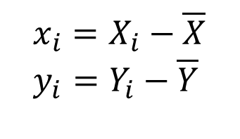
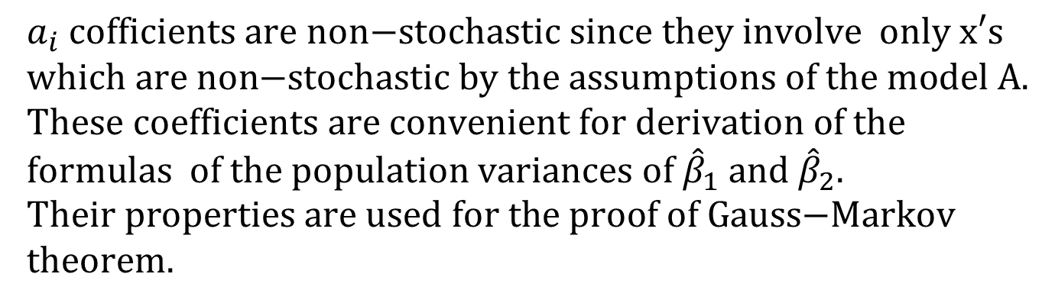
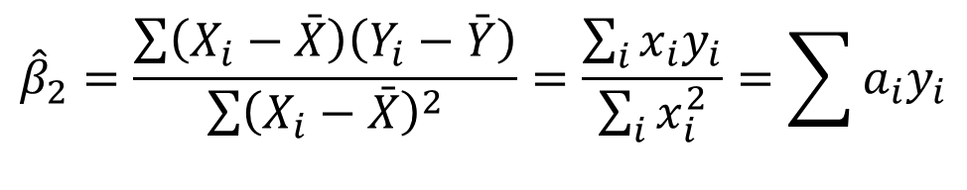
COEFFICIENTS a_{i}
$$x_{i}=X_{i}−\overline{X} \\ y_{i}=Y_{i}−\overline{Y}$$
$$a_{i}=\frac{X_{i}−\overline{X}}{\sum_{j=1}^{n}{{\left(X_{j}−\overline{X}\right)}^{2}}}$$
$${\hat{β}}_{2}=\frac{\sum{\left(X_{i}−\bar{X}\right)\left(Y_{i}−\bar{Y}\right)}}{\sum{{\left(X_{i}−\bar{X}\right)}^{2}}}=\frac{\sum_{i}{x_{i}y_{i}}}{\sum_{i}{x_{i}^{2}}}=\sum{a_{i}y_{i}}$$
$$a_{i} \text{cofficients} \text{are} \text{non}\text{−}\text{stochastic} \text{since} \text{they} \text{involve} \text{only} \text{x}\text{′}\text{s} \\ \text{which} \text{are} \text{non}\text{−}\text{stochastic} \text{by} \text{the} \text{assumptions} \text{of} \text{the} \text{model} \text{A}\text{.} \\ \text{These} \text{coefficients} \text{are} \text{convenient} \text{for} \text{derivation} \text{of} \text{the} \text{formulas} \text{of} \text{the} \text{population} \text{variances} \text{of} {\hat{β}}_{1} \text{and} {\hat{β}}_{2}. \\ \text{Their} \text{properties} \text{are} \text{used} \text{for} \text{the} \text{proof} \text{of} \text{Gauss}\text{−}\text{Markov} \text{theorem}\text{.}$$

Slide 4
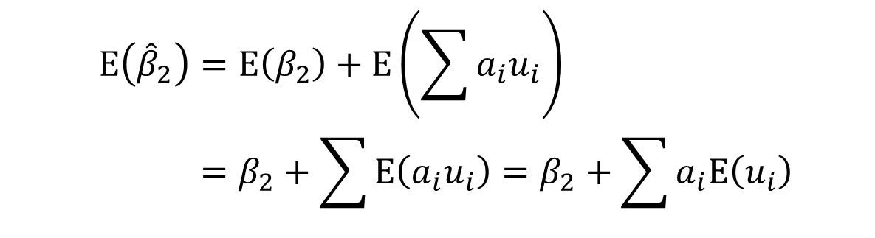
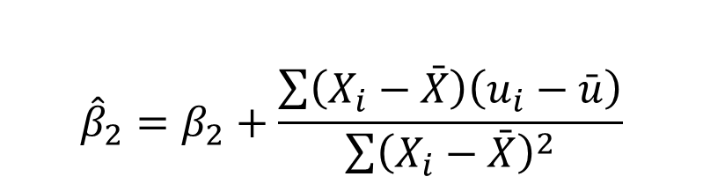

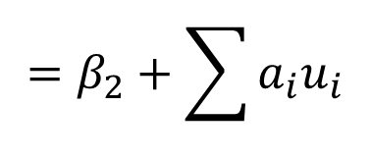
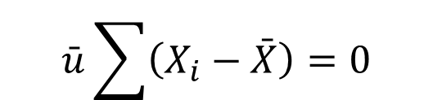
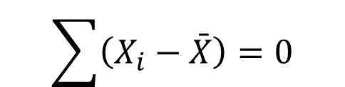
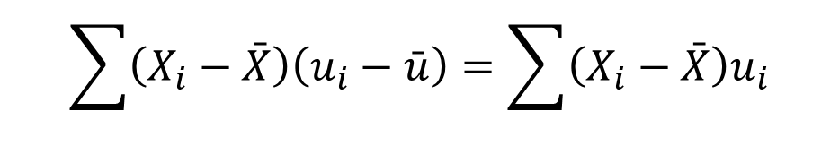
UNBIASEDNESS OF THE REGRESSION COEFFICIENTS
$${\hat{β}}_{2}=β_{2}+\frac{\sum{\left(X_{i}−\bar{X}\right)\left(u_{i}−\bar{u}\right)}}{\sum{{\left(X_{i}−\bar{X}\right)}^{2}}}$$
$$=β_{2}+\sum{a_{i}u_{i}}$$
$$\sum{\left(X_{i}−\bar{X}\right)\left(u_{i}−\bar{u}\right)}=\sum{\left(X_{i}−\bar{X}\right)u_{i}}$$
$$\bar{u}\sum{\left(X_{i}−\bar{X}\right)}=0$$
$$\sum{\left(X_{i}−\bar{X}\right)}=0$$
$$\text{since}$$
$$E\left({\hat{β}}_{2}\right)=E\left(β_{2}\right)+E\left(\sum{a_{i}u_{i}}\right) \\ =β_{2}+\sum{E\left(a_{i}u_{i}\right)}=β_{2}+\sum{a_{i}E\left(u_{i}\right)}=β_{2}$$
The proof of unbiasedness of the intercept estimator will be done below.

Slide 5
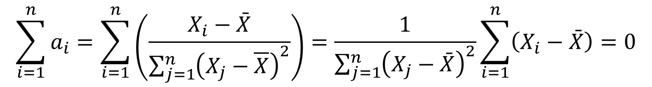
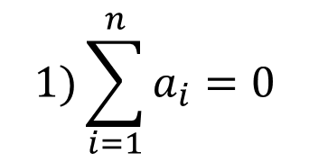
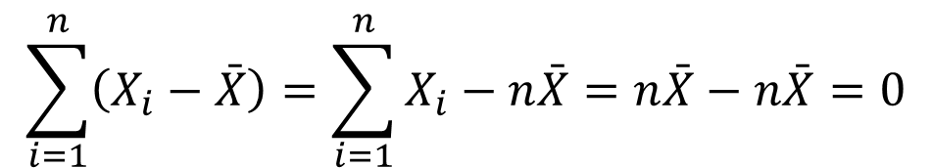
PROPERTIES OF COEFFICIENTS a_{i}
$$1)\sum_{i=1}^{n}{a_{i}=0}$$
$$\sum_{i=1}^{n}{a_{i}}=\sum_{i=1}^{n}{\left(\frac{X_{i}−\bar{X}}{\sum_{j=1}^{n}{{\left(X_{j}−\overline{X}\right)}^{2}}}\right)}=\frac{1}{\sum_{j=1}^{n}{{\left(X_{j}−\bar{X}\right)}^{2}}}\sum_{i=1}^{n}{\left(X_{i}−\bar{X}\right)}=0$$
$$\sum_{i=1}^{n}{\left(X_{i}−\bar{X}\right)}=\sum_{i=1}^{n}{X_{i}}−n\bar{X}=n\bar{X}−n\bar{X}=0$$

Slide 6
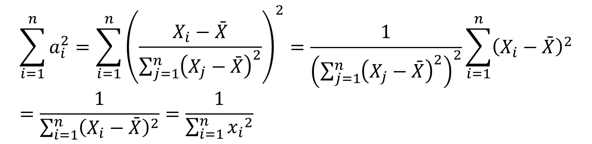

PROPERTIES OF COEFFICIENTS a_{i}
$$2)\sum_{i=1}^{n}{a_{i}^{2}}=\frac{1}{\sum_{i=1}^{n}{{\left(X_{i}−\bar{X}\right)}^{2}}}=\frac{1}{\sum_{i=1}^{n}{{x_{i}}^{2}}}$$
$$\sum_{i=1}^{n}{a_{i}^{2}}=\sum_{i=1}^{n}{{\left(\frac{X_{i}−\bar{X}}{\sum_{j=1}^{n}{{\left(X_{j}−\bar{X}\right)}^{2}}}\right)}^{2}}=\frac{1}{{\left(\sum_{j=1}^{n}{{\left(X_{j}−\bar{X}\right)}^{2}}\right)}^{2}}\sum_{i=1}^{n}{{\left(X_{i}−\bar{X}\right)}^{2}}=\frac{1}{\sum_{i=1}^{n}{{\left(X_{i}−\bar{X}\right)}^{2}}}=\frac{1}{\sum_{i=1}^{n}{{x_{i}}^{2}}}$$

Slide 7
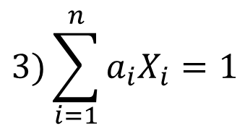
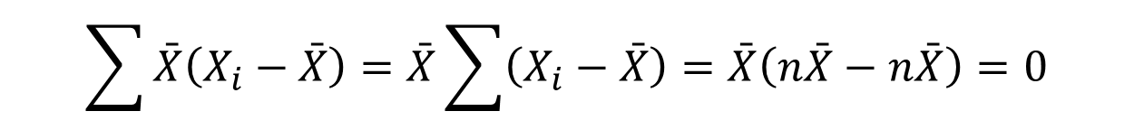
PROPERTIES OF COEFFICIENTS a_{i}
$$3)\sum_{i=1}^{n}{a_{i}X_{i}=1}$$
$$\sum_{i=1}^{n}{a_{i}X_{i}=\sum_{i=1}^{n}{\frac{\left(X_{i}−\bar{X}\right)X_{i}}{\sum_{j=1}^{n}{{\left(X_{j}−\bar{X}\right)}^{2}}}}=\frac{1}{\sum_{j=1}^{n}{{\left(X_{j}−\bar{X}\right)}^{2}}}\sum_{i=1}^{n}{\left(X_{i}−\bar{X}\right)X_{i}}=\frac{\sum_{i=1}^{n}{{\left(X_{i}−\bar{X}\right)}^{2}}}{\sum_{j=1}^{n}{{\left(X_{j}−\bar{X}\right)}^{2}}}=1}.$$
$$\sum{\bar{X}\left(X_{i}−\bar{X}\right)}=\bar{X}\sum{\left(X_{i}−\bar{X}\right)}=\bar{X}\left(n\bar{X}−n\bar{X}\right)=0$$

Slide 8



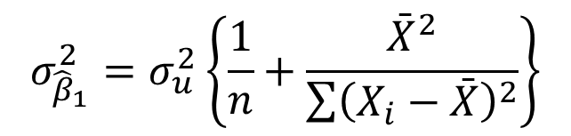


PRECISION OF THE REGRESSION COEFFICIENTS
Simple regression model: Y = β₁ + β₂X + u
$$σ_{{\hat{β}}_{2}}^{2}=\frac{σ_{u}^{2}}{\sum{{\left(X_{i}−\bar{X}\right)}^{2}}}$$
$$σ_{{\hat{β}}_{1}}^{2}=σ_{u}^{2}\left\{\frac{1}{n}+\frac{{\bar{X}}^{2}}{\sum{{\left(X_{i}−\bar{X}\right)}^{2}}}\right\}$$
For the variance of :
- The larger is the population variance of u, the larger is the variance of .
the larger is the sum of the squared deviations of X, the smaller is the variance of .
The variance of is also growing with the (mean X)² growth.
$${\hat{β}}_{2}$$
$${\hat{β}}_{2}$$
$${\hat{β}}_{2}$$
$${\hat{β}}_{1}$$

Slide 9
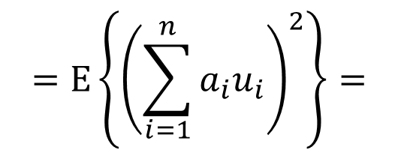

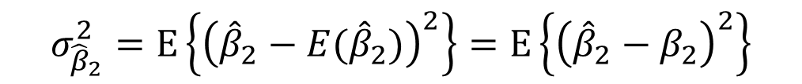
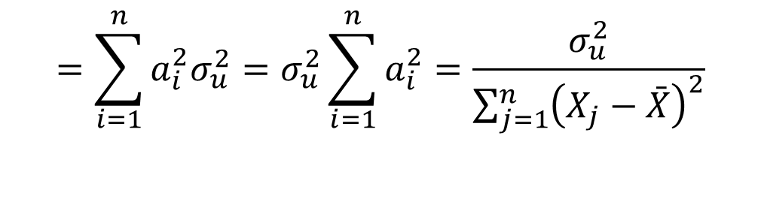
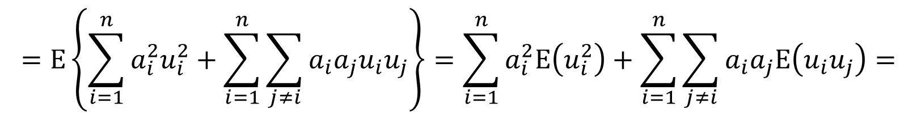
$${\hat{β}}_{2}$$
PRECISION OF THE REGRESSION COEFFICIENTS: PROOF FOR
$$=E\left\{{\left(\sum_{i=1}^{n}{a_{i}u_{i}}\right)}^{2}\right\}=$$
$$σ_{{\hat{β}}_{2}}^{2}=E\left\{{\left({\hat{β}}_{2}−E({\hat{β}}_{2})\right)}^{2}\right\}=E\left\{{\left({\hat{β}}_{2}−β_{2}\right)}^{2}\right\}$$
$$=E\left\{\sum_{i=1}^{n}{a_{i}^{2}u_{i}^{2}}+\sum_{i=1}^{n}{\sum_{j≠i}{a_{i}a_{j}u_{i}u_{j}}}\right\}=\sum_{i=1}^{n}{a_{i}^{2}E\left(u_{i}^{2}\right)}+\sum_{i=1}^{n}{\sum_{j≠i}{a_{i}a_{j}E\left(u_{i}u_{j}\right)}}=$$
$$=\sum_{i=1}^{n}{a_{i}^{2}σ_{u}^{2}}=σ_{u}^{2}\sum_{i=1}^{n}{a_{i}^{2}}=\frac{σ_{u}^{2}}{\sum_{j=1}^{n}{{\left(X_{j}−\bar{X}\right)}^{2}}}$$

Slide 10
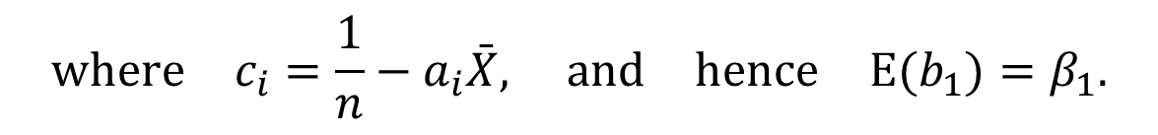

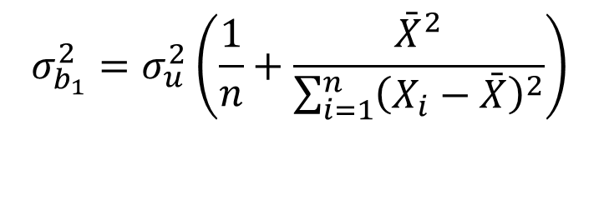
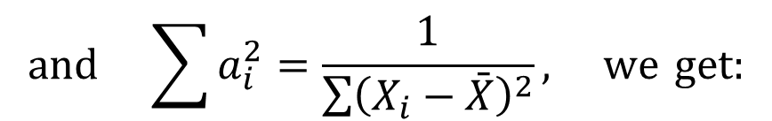
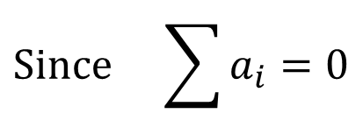
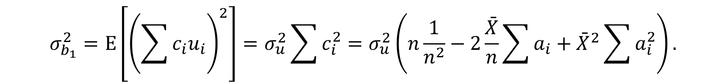
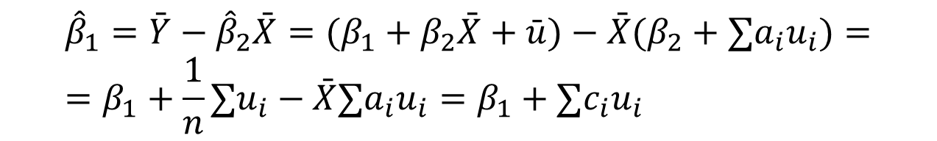
$${\hat{β}}_{1}$$
PRECISION OF THE REGRESSION COEFFICIENTS: PROOF FOR
$${\hat{β}}_{1}=\bar{Y}−{\hat{β}}_{2}\bar{X}=(β_{1}+β_{2}\bar{X}+\bar{u})−\bar{X}(β_{2}+∑a_{i}u_{i})= \\ =β_{1}+\frac{1}{n}∑u_{i}−\bar{X}∑a_{i}u_{i}=β_{1}+∑c_{i}u_{i}$$
$$where c_{i}=\frac{1}{n}−a_{i}\bar{X}, and hence E(b_{1})=β_{1}.$$
$$σ_{b_{1}}^{2}=E\left[{\left(\sum{c_{i}u_{i}}\right)}^{2}\right]=σ_{u}^{2}\sum{c_{i}^{2}}=σ_{u}^{2}\left(n\frac{1}{n^{2}}−2\frac{\bar{X}}{n}\sum{a_{i}}+{\bar{X}}^{2}\sum{a_{i}^{2}}\right).$$
,
$$Since \sum{a_{i}=0}$$
$$and \sum{a_{i}^{2}=\frac{1}{\sum{{\left(X_{i}−\bar{X}\right)}^{2}}}}, we get:$$
$$σ_{b_{1}}^{2}=σ_{u}^{2}\left(\frac{1}{n}+\frac{{\bar{X}}^{2}}{\sum_{i=1}^{n}{{\left(X_{i}−\bar{X}\right)}^{2}}}\right)$$

Slide 11
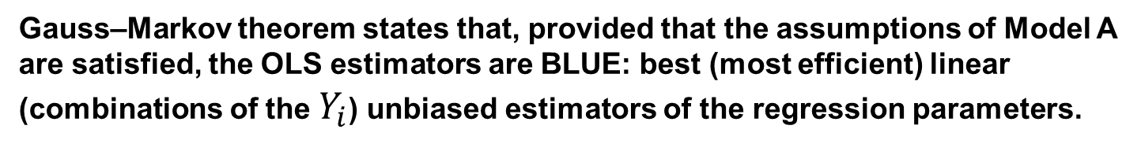
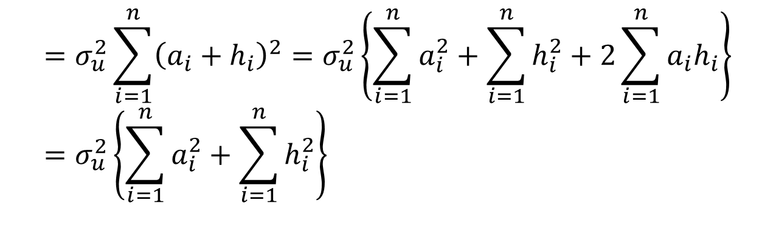
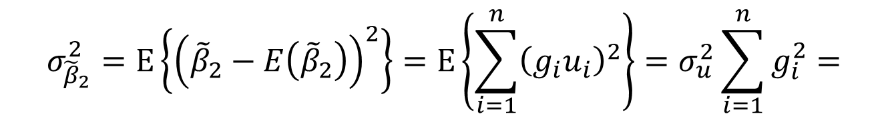
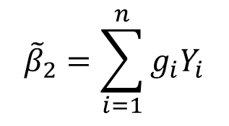
GAUSS-MARKOV THEOREM
Gauss–Markov theorem states that, provided that the assumptions of Model A
are satisfied, the OLS estimators are BLUE: best (most efficient) linear
(combinations of the $Y_{i}$) unbiased estimators of the regression parameters.
$${\tilde{β}}_{2}=\sum_{i=1}^{n}{g_{i}Y_{i}}$$
$$σ_{{\tilde{β}}_{2}}^{2}=E\left\{{\left({\tilde{β}}_{2}−E\left({\tilde{β}}_{2}\right)\right)}^{2}\right\}=E\left\{\sum_{i=1}^{n}{{\left(g_{i}u_{i}\right)}^{2}}\right\}=σ_{u}^{2}\sum_{i=1}^{n}{g_{i}^{2}}=$$
$$=σ_{u}^{2}\sum_{i=1}^{n}{{\left(a_{i}+h_{i}\right)}^{2}}=σ_{u}^{2}\left\{\sum_{i=1}^{n}{a_{i}^{2}}+\sum_{i=1}^{n}{h_{i}^{2}}+2\sum_{i=1}^{n}{a_{i}h_{i}}\right\} \\ =σ_{u}^{2}\left\{\sum_{i=1}^{n}{a_{i}^{2}}+\sum_{i=1}^{n}{h_{i}^{2}}\right\}$$

Slide 12

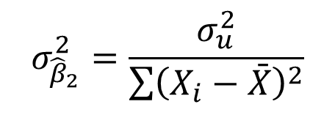
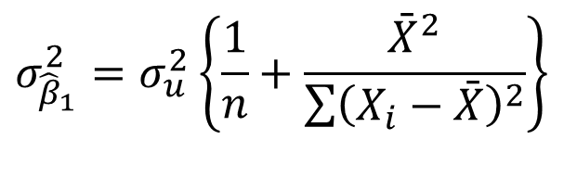
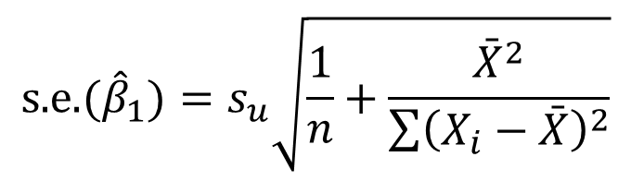
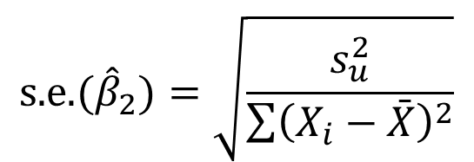
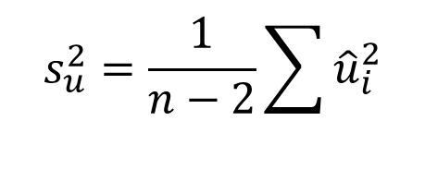

STANDARD DEVIATIONS OF THE REGRESSION COEFFICIENTS
$$σ_{{\hat{β}}_{1}}^{2}=σ_{u}^{2}\left\{\frac{1}{n}+\frac{{\bar{X}}^{2}}{\sum{{\left(X_{i}−\bar{X}\right)}^{2}}}\right\}$$
$$σ_{{\hat{β}}_{2}}^{2}=\frac{σ_{u}^{2}}{\sum{{\left(X_{i}−\bar{X}\right)}^{2}}}$$
$$s_{u}^{2}=\frac{1}{n−2}\sum{{\hat{u}}_{i}^{2}}$$
S_{u} - standard error of regression.
Standard errors of regression coefficients:
$$\text{s}\text{.}\text{e}\text{.}({\hat{β}}_{1})=s_{u}\sqrt{\frac{1}{n}+\frac{{\bar{X}}^{2}}{\sum{{\left(X_{i}−\bar{X}\right)}^{2}}}}$$
$$\text{s}\text{.}\text{e}\text{.}({\hat{β}}_{2})=\sqrt{\frac{s_{u}^{2}}{\sum{{\left(X_{i}−\bar{X}\right)}^{2}}}}$$
$${\hat{β}}_{1}$$
We obtain estimates of the standard deviations of the distributions of and by substituting s_{u}² for σ_{u}² in the variance expressions and taking the square roots.
$${\hat{β}}_{2}$$

Slide 13



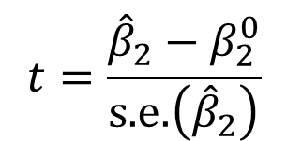


t TESTS OF HYPOTHESES RELATING TO REGRESSION COEFFICIENTS
True model Fitted model
$$Y=β_{1}+β_{2}X+u$$
$$\hat{Y}={\hat{β}}_{1}+{\hat{β}}_{2}X$$
Null hypothesis
$$H_{0}:β_{2}=β_{2}^{0},$$
Alternative (two-sided) hypothesis
$$H_{1}:β_{2}≠β_{2}^{0}$$
$$t=\frac{{\hat{β}}_{2}−β_{2}^{0}}{\text{s}\text{.}\text{e}\text{.}\left({\hat{β}}_{2}\right)}$$
Test statistic
Reject H₀ if
$$\left|t\right|>t_{\text{crit}}$$
d.f. = n-2

Slide 14

ONE-SIDED t TESTS OF HYPOTHESES RELATING TO REGRESSION COEFFICIENTS
Null hypothesis: H₀: β₂ = 0
Alternative hypothesis: H₁: β₂ > 0
probability density
function of
$${\hat{β}}_{2}$$
do not reject H₀
reject H₀
5%
0
tcrit_{5%*}s.e.

Slide 15






CONFIDENCE INTERVALS FOR REGRESSION COEFFICIENTS
$$Y=β_{1}+β_{2}X+u$$
Model
Null hypothesis:
Alternative hypothesis:
$$H_{0}:β_{2}=β_{2}^{0}$$
$$H_{1}:β_{2}≠β_{2}^{0}$$
$$\frac{{\hat{β}}_{2}−β_{2}^{0}}{\text{s}\text{.}\text{e}\text{.}\left({\hat{β}}_{2}\right)}>t_{\text{crit}}$$
$$\frac{{\hat{β}}_{2}−β_{2}^{0}}{\text{s}\text{.}\text{e}\text{.}\left({\hat{β}}_{2}\right)}<−t_{\text{crit}}$$
Reject H₀ if or
Reject H₀ if or
Reject H₀ if or
Do not reject H₀ if
$${\hat{β}}_{2}−β_{2}^{0}<−\text{s}\text{.}\text{e}\text{.}\left({\hat{β}}_{2}\right)×t_{\text{crit}}$$
$${\hat{β}}_{2}−\text{s}\text{.}\text{e}\text{.}\left({\hat{β}}_{2}\right)×t_{\text{crit}}≤β_{2}≤{\hat{β}}_{2}+\text{s}\text{.}\text{e}\text{.}\left({\hat{β}}_{2}\right)×t_{\text{crit}}$$
$$({\hat{β}}_{2}−\text{s}\text{.}\text{e}\text{.}\left({\hat{β}}_{2}\right)×t_{\text{crit}};{\hat{β}}_{2}+\text{s}\text{.}\text{e}\text{.}\left({\hat{β}}_{2}\right)×t_{\text{crit}})$$
- Confidence interval

Slide 16
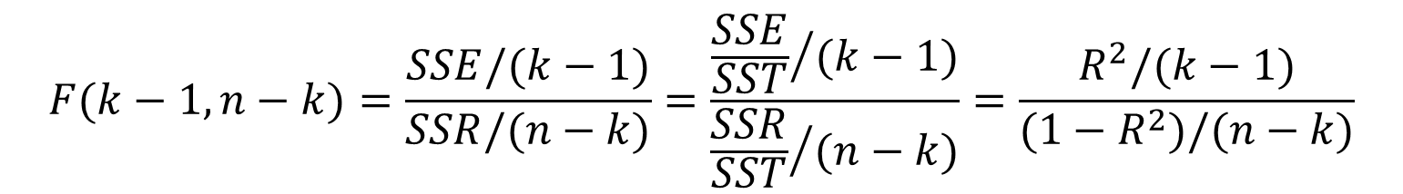
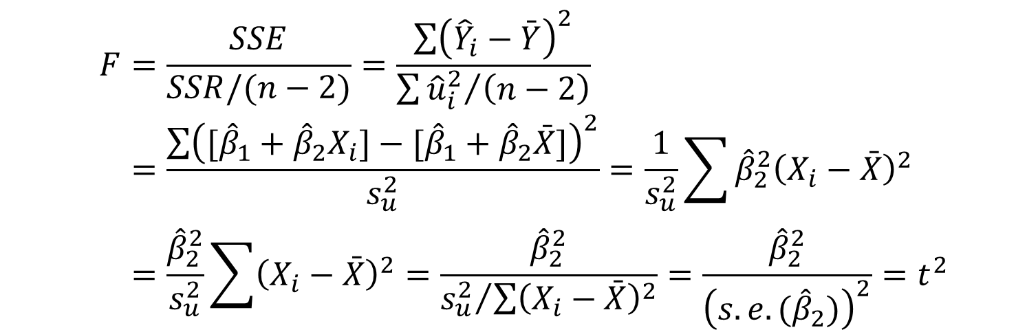
F TEST OF GOODNESS OF FIT
Demonstration that F = t ² IN THE SLR MODEL
$$F(k−1,n−k)=\frac{SSE/(k−1)}{SSR/(n−k)}=\frac{{\frac{SSE}{SST}}/{(k−1)}}{{\frac{SSR}{SST}}/{(n−k)}}=\frac{R^{2}/(k−1)}{(1−R^{2})/(n−k)}$$
$$F=\frac{SSE}{SSR/(n−2)}=\frac{\sum{{\left({\hat{Y}}_{i}−\bar{Y}\right)}^{2}}}{{\sum{{\hat{u}}_{i}^{2}}}/{\left(n−2\right)}} \\ =\frac{\sum{{\left([{\hat{β}}_{1}+{\hat{β}}_{2}X_{i}]−[{\hat{β}}_{1}+{\hat{β}}_{2}\bar{X}]\right)}^{2}}}{s_{u}^{2}}=\frac{1}{s_{u}^{2}}\sum{{\hat{β}}_{2}^{2}{\left(X_{i}−\bar{X}\right)}^{2}} \\ =\frac{{\hat{β}}_{2}^{2}}{s_{u}^{2}}\sum{{\left(X_{i}−\bar{X}\right)}^{2}}=\frac{{\hat{β}}_{2}^{2}}{{s_{u}^{2}}/{\sum{{\left(X_{i}−\bar{X}\right)}^{2}}}}=\frac{{\hat{β}}_{2}^{2}}{{\left(s.e.({\hat{β}}_{2})\right)}^{2}}=t^{2}$$
The F test does not have its own role in the SLR model; it will do in the multiple regression.

Slide 17
The of Real GDP (PPP) per capita and Life expectancy at birth (2020) World Development Indicators

Slide 18
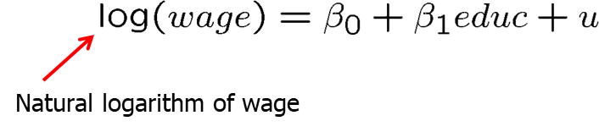
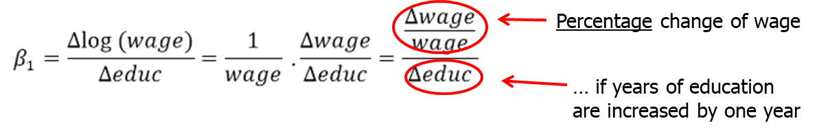
The Simple Regression Model: some nonlinearities
Semi-logarithmic form
Regression of log wages on years of education
This changes the interpretation of the regression coefficient:

Slide 19
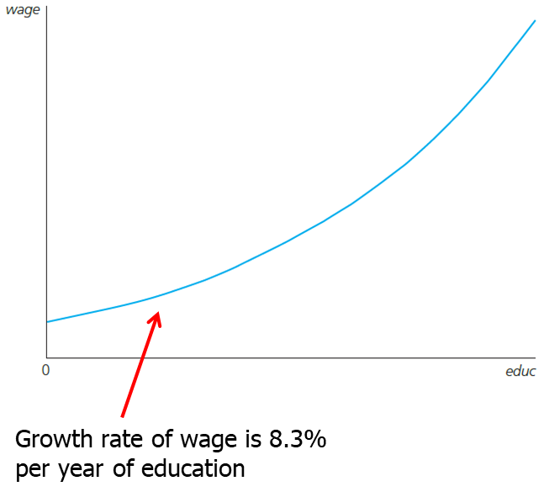
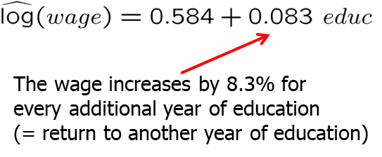
The Simple Regression Model: some nonlinearities
Fitted regression

Slide 20
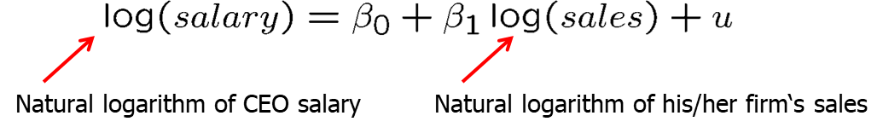
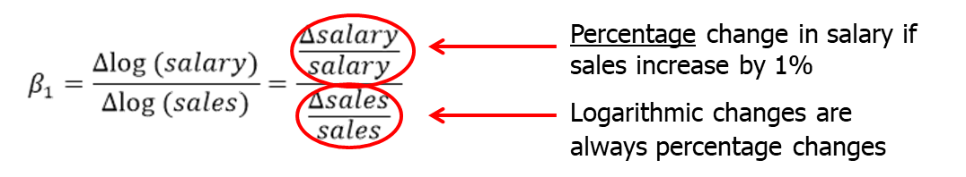
The Simple Regression Model: some nonlinearities
Incorporating nonlinearities: Log-logarithmic form
Chief Executive Officer (CEO) salary and firm sales
This changes the interpretation of the regression coefficient:

Slide 21
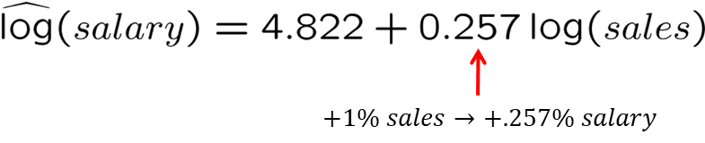
The Simple Regression Model: some nonlinearities
CEO salary and firm sales: fitted regression
The double log form means a constant elasticity model, whereas the semi-log form assumes the relation between the absolute and relative changes

